Slide 1

Marianne M. Jennings
Business
Its Legal, Ethical, and Global Environment
10th Ed.
Chapter 3 The Judicial System

Slide 2
Types of Courts
Trial Courts
Place where case begins
Jury hears cases and decides disputed issues of fact
Single judge presides over case
Appellate Courts
Review actions of trial court
Usually have published opinions for uniformity and consistency
No trials held – panel of judges hears case

Slide 3
How Courts Make Decisions
Process of Judicial Review (Appellate)
Determine whether error was made
Transcript is reviewed
All other evidence is reviewed
Parties submit written briefs to summarize the evidence and issues

Slide 4
How Courts Make Decisions
Process of Judicial Review (Appellate)
Oral arguments may be made before panel of judges
Generally three judges, but at U.S. Supreme Court level it is nine
En banc : full bench hears case
Judges vote on whether there is reversible error
Error that might have affected the outcome

Slide 5
How Courts Make Decisions
Process of Judicial Review (Appellate)
Possible actions of reviewing court
Affirm—no reversible error and decision stands
Reverse—reversible error and decision is reversed
Remand—error that requires further proceedings
Modify—change ruling of lower court
Statutory interpretation
Courts at appellate level can review statutory application
Can determine scope of statute

Slide 6
Consider (p. 76)
The Porch/Stoop and the Law Student
Is visible drinking on private property covered by a statute that prohibits public drinking?
Consider the implications – how far would the statute go – if you could see through an open window or open door that someone was drinking?
Intent of statute
Exceptions for neighborhood parties

Slide 7
How Courts Make Decisions
Process of Judicial Review
Judicial review and case precedent—the doctrine of stare decisis
Courts will follow previous decisions for consistency
Previous decisions are called precedent

Slide 8
How Courts Make Decisions
Process of Judicial Review
Exceptions to stare decisis—when precedent may not be followed
Cases are factually distinguishable
Precedent is from another jurisdiction
Technology changes
Sociological, moral, or economic changes
Interpreting precedent
The rule of law in the case is the precedent
Dicta is not the precedent
Dicta is the discussion of the relevant law

Slide 9
Parties in the Judicial System
Plaintiffs
Initiate the lawsuit
Called petitioners in some cases
Defendants
Alleged to have violated some right of the plaintiff
Party named in the suit for recovery

Slide 10
Parties in the Judicial System
Lawyers
Those who act as advocates for plaintiffs and defendants
Have fiduciary relationship with clients
Represent client and see that procedures are followed
Privilege exists with client
Must keep what client tells them confidential
Exception is advance notice of crime to be committed

Slide 11
Parties in the Judicial System
Plaintiffs – originate suite Represented
Defendants – party from whom plaintiff seeks recovery By Lawyers
INTERNATIONAL LAWYERS
Avocati
Italy Procuratori
Advocate – High Courts
Quebec/France Notaire – Real Property Transactions
Juridique – Legal Counselor
Japan Bengoshi
Great Britain/ Solicitors – Advice, Documents
Canada Barristers – Higher Courts
Rechtsanwalt – Litigator
Germany Rechtsbeistand - Advice

Slide 12
Parties in the Judicial System
Judges
Can control proceedings or outcomes
Can be elected or appointed
Trial or Appellate
Trial Judge presides over trial
Appellate Judge hears appeal from trial court

Slide 13
Parties in the Judicial System
Name Changes for Parties on Appeal
Appellant or Petitioner: Party appealing the lower court’s decision
Appellee or Respondent: Party who won below and is not appealing
Some states reverse the name of the case on appeal; example: Smith v. Jones - trial court, Jones loses and appeals; Jones v. Smith - appellate court

Slide 14
Jurisdiction
Jurisdiction is the Authority of a Court to Hear a Case
Types of Jurisdiction
Subject matter jurisdiction is jurisdiction over the subject matter of the case
In personam jurisdiction is jurisdiction over the parties in a case

Slide 15
Federal Court System

Slide 16
Federal Court System
Federal District Court
General trial court of the federal system
Subject matter jurisdiction
When U.S. is a party
Federal question
Diversity of citizenship

Slide 17
Federal Court System
Limited Jurisdiction
One issue that arises is what law will be applied to the case
Federal courts apply state law, they do not make up a new system of federal common law

Slide 18
Federal Court System
Specialized Courts—Courts of Limited Original Jurisdiction
Tax court
Bankruptcy court
Claims Court
Judge Advocate General (military courts)
Courts for other agencies
Court of International Trade

Slide 19
Structure
There are ninety-four federal districts
Each state is at least one federal district and Puerto Rico and DC are also federal districts (94 courts)
Virgin Islands, Guam, and Northern Mariana islands also have a federal court
Number of districts per state is determined by population and case load

Slide 20
Federal Court System
Federal District Court Opinions
Opinions are reported in the Federal Supplement
Cite: F.Supp. (F.Supp.2d.)
Example: National Federation of Independent Business v. Sebelius, 780 F. Supp. 2d 1307 (N.D. 2011)

Slide 21
Federal Court System
Court of Appeals
Formerly known as U.S. Circuit Court of Appeals
Thirteen federal circuits
Generally a panel of three judges reviews appeals from Federal District Court
Opinions found in Federal Reporter
Cite: F., F.2d or F.3d.
Brown v Entertainment Merchants Assoc., 556 F.3d 950 (9th Cir. 2010)

Slide 22
Federal Court System
Supreme Court
Must decide to review cases
Issues writs of certiorari on those cases they will review-determined by the rule of four
Has original jurisdiction for
Disputes between and/or among states
Charges of espionage or ambassadors and foreign consuls

Slide 23
Federal Court System
Supreme Court
Nine judges with lifetime appointments
Opinions reported in:
United States Reports—official reports
Citizens United v Federal Election Com’n, 558 U.S. 310 (2010), 130 S.Ct. 876 (2010), 175 L.Ed.2d 753 (2010)

Slide 24

State Court Systems

Slide 25
State Court Systems
General Trial Court
Usually called superior, circuit, district, or county court
Opinions reported in regional reporters.
Example: Pacific Reporter, P. or P.2d.
Opinions also reported in state reporters
Example: 45 Wash.App. 442, 725 P.2d 1022 (1986)

Slide 26
State Court Systems
Lesser Courts
Small claims: Lesser damage claims, no Lawyer
Justice of the Peace courts
Smaller damage claims
Lawyers permitted to appear
Traffic courts: For citations
Probate courts: For wills, guardianships, conservatorships, etc.

Slide 27
Regional Reporter State Groupings
Pacific (P. or P.2d)
Alaska
Arizona
(California)
Colorado
Hawaii
Idaho
Kansas
Montana
Nevada
New Mexico
Oklahoma
Oregon
Utah
Washington
Wyoming
Northwestern (N.W. or N.W.2d)
Iowa
Michigan
Minnesota
Nebraska
North Dakota
South Dakota
Wisconsin
Southwestern (S.W. or S.W.2d)
Arkansas
Kentucky
Missouri
Tennessee
Texas

Slide 28
Regional Reporter State Groupings
Northeastern (N.E. or N.E. 2d)
Illinois
Indiana
Massachusetts
(New York)
Ohio
Atlantic (A. or 2d)
Connecticut
Delaware
District of Columbia
Maine
Maryland
New Hampshire
New Jersey
Pennsylvania
Rhode Island
Vermont
Southeastern (S.E. or S.E.2d)
Georgia
North Carolina
South Carolina
Virginia
West Virginia
Southern (So. or So.2d)
Alabama
Florida
Louisiana
Mississippi
Note: California and New York each has its own reporter system. Source: The national reporter system was developed by West Publishing Company. Reprinted with permission of West Publishing Company.

Slide 29
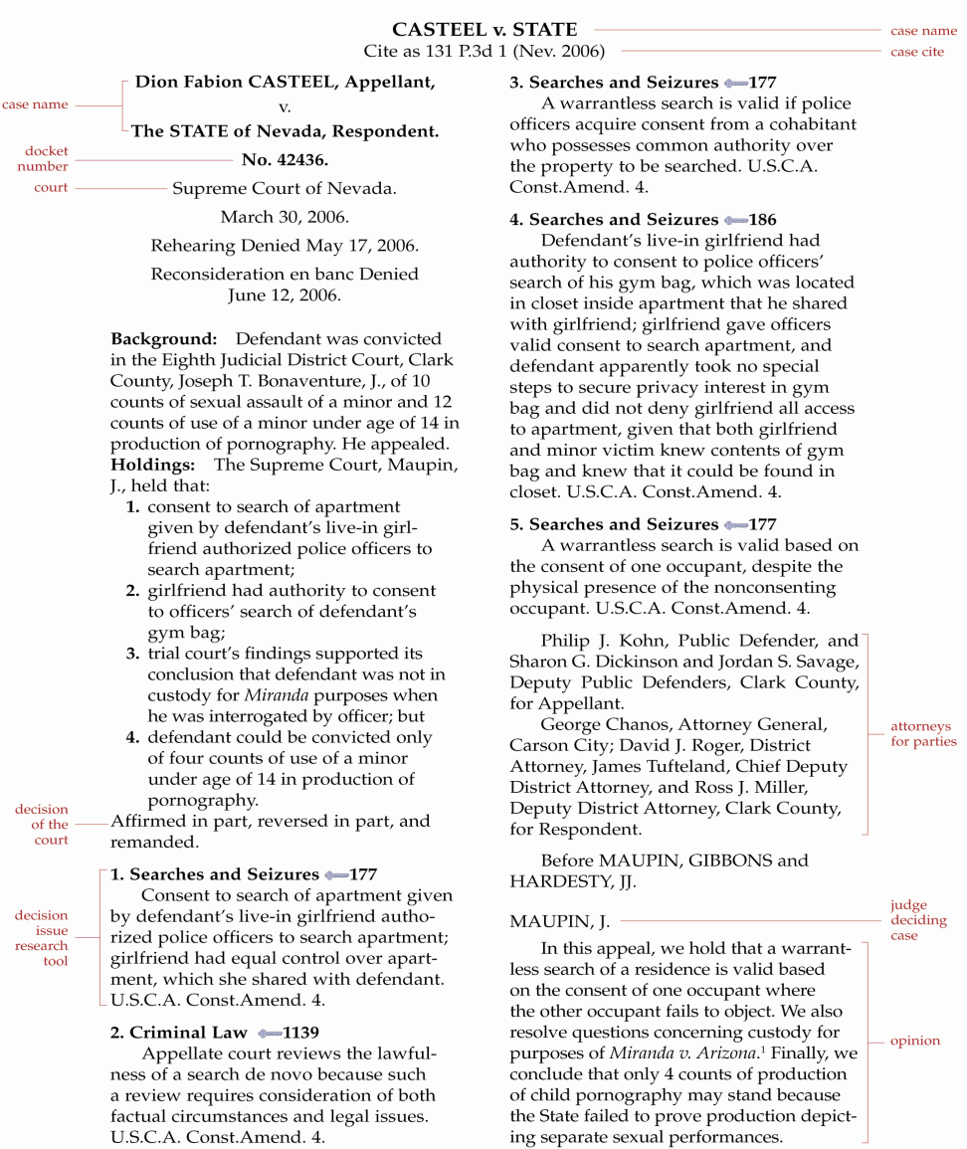
Sample Page of a National Reporter Case

Slide 30
State Court Systems
Venue
Location of court in the system within a jurisdiction
Venue in criminal cases can change from location of crime to another court if press coverage is excessive
Civil venue is often where defendant resides or where the cause of action occurred

Slide 31
Personal Jurisdiction

Slide 32
In Personam Jurisdiction
Means for Acquiring Jurisdiction
Property ownership in the state = in rem jurisdiction
Volunteer—parties agree to it
Presence in the state
Residence
Corporations incorporated or doing business in the state
Minimum contacts - constitutional standards of contact with a state (“Long-Arm” Statutes)

Slide 33
Minimum Contacts and Long-Arm Statutes
Case 3.1 E & H Cruises, Ltd. v. Baker (2012)
How much of a presence did the pirate ship company have in the United States? What about the cruise company?
What happens if the defendant is not required to come to the United States to defend the suit?
What are the implications if the company is not required to come and defend the lawsuit?
3-32

Slide 34
The International Courts
International Court of Justice (ICJ)
Part of U.N.
Jurisdiction is contentious (parties must agree to submit)
EU Courts
Court of Justice of European Communities
European Court of Human Rights
Inter-American Court of Human Rights
Opinion Found in International Law Reports

Slide 35
The International Courts
London’s Commercial Court
Site of many international arbitrations
Jurisdiction Issues in International Courts
Similar to in personam jurisdiction

Slide 36
The International Courts
Conflicts of Law
Court systems vary
Tort recovery more liberal in U.S.
No contingency fees allowed elsewhere

